Slide 1
第18、19讲 传输层安全

Slide 2
Web安全威胁
现在商业界，政府，工业界广泛采用Web
但是Web是容易遭受攻击的
有各种各样的威胁
完整性
机密性
拒绝服务
认证
Notes:
The World Wide Web is widely used by businesses, government agencies, and many individuals. But the Internet and the Web are extremely vulnerable to compromises of various sorts, with a range of threats as shown briefly above, and in detail in Stallings Table 5.1. These can be described as passive attacks including eavesdropping on network traffic between browser and server and gaining access to information on a Web site that is supposed to be restricted; and active attacks including impersonating another user, altering messages in transit between client and server, and altering information on a Web site. The web needs added security mechanisms to address these threats.

Slide 3
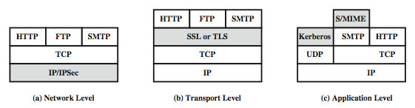
Web流量安全方法
Notes:
A number of approaches to providing Web security are possible. The various approaches that have been considered are similar in the services they provide and, to some extent, in the mechanisms that they use, but they differ with respect to their scope of applicability and their relative location within the TCP/IP protocol stack. Stallings Figure 16.1 illustrates this difference.
One way to provide Web security is to use IP Security (Figure 16.1a). The advantage of using IPSec is that it is transparent to end users and applications and provides a general-purpose solution. Further, IPSec includes a filtering capability so only selected traffic need incur the IPSec processing overhead.
Another relatively general-purpose solution is to implement security just above TCP (Figure 16.1b). The foremost example of this approach is the Secure Sockets Layer (SSL) and the follow-on Internet standard known as Transport Layer Security (TLS). At this level, there are two implementation choices. For full generality, SSL (or TLS) could be provided as part of the underlying protocol suite and therefore be transparent to applications. Alternatively, SSL can be embedded in specific packages, e.g. both the Netscape and Microsoft Explorer browsers come with SSL, & most Web servers have implemented it.
Application-specific security services are embedded within the particular application. Figure 16.1c shows examples of this architecture. The advantage of this approach is that the service can be tailored to the specific needs of a given application.

Slide 4
SSL (安全套接层)
传输层安全服务
Netscape 发明了 安全套接层（ＳＳＬ）
第三版是经过公开讨论和工业界使用
接着成为互联网标准 TLS (Transport Layer Security)
采用TCP 提供一种可靠的端对端的安全服务
SSL 由两层协议组成
Notes:
SSL probably most widely used Web security mechanism, and it is implemented at the Transport layer (cf. figure 16.1b on previous slide).
SSL is designed to make use of TCP to provide a reliable end-to-end secure service. Netscape originated SSL. Version 3 of the protocol was designed with public review and input from industry and was published as an Internet draft document. Subsequently, when a consensus was reached to submit the protocol for Internet standardization, the TLS working group was formed within IETF to develop a common standard. This first published version of TLS can be viewed as essentially an SSLv3.1 and is very close to and backward compatible with SSLv3. SSL is not a single protocol but rather two layers of protocol, as shown next.

Slide 5
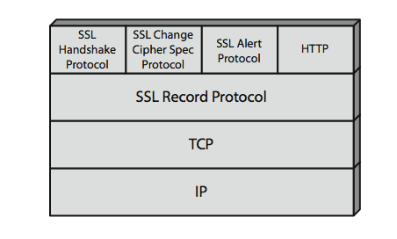
SSL 体系结构
Notes:
Stallings Figure 5.2 shows the SSL Protocol stack.
The SSL Record Protocol provides basic security services to various higher-layer protocols. In particular, the Hypertext Transfer Protocol (HTTP), which provides the transfer service for Web client/server interaction, can operate on top of SSL.
Three higher-layer protocols are also defined as part of SSL: the Handshake Protocol, Change Cipher Spec Protocol, and Alert Protocol. These SSL-specific protocols are used in the management of SSL exchanges.

Slide 6
SSL 体系结构
SSL 连接
一个短暂的，点对点的，传输连接
每一条连接与一个会话相关联
SSL 会话
客户与服务器之间的一种关联
通过握手协议来创建
定义了密码安全参数集合
多个安全连接之间共享
Notes:
Two important SSL concepts are the SSL connection and the SSL session:
• Connection: A connection is a network transport that provides a suitable type of service, such connections are transient, peer-to-peer relationships, associated with one session
• Session: An SSL session is an association between a client and a server, created by the Handshake Protocol. Sessions define a set of cryptographic security parameters, which can be shared among multiple connections. Sessions are used to avoid the expensive negotiation of new security parameters for each connection.
Between any pair of parties (applications such as HTTP on client and server), there may be multiple secure connections. In theory, there may also be multiple simultaneous sessions between parties, but this feature is not used in practice.
There are a number of states associated with each session. Once a session is established, there is a current operating state for both read and write (i.e., receive and send). In addition, during the Handshake Protocol, pending read and write states are created. Upon successful conclusion of the Handshake Protocol, the pending states become the current states. A session state and a connection state are defined by sets of parameters, see text for details.

Slide 7
SSL 记录协议服务
机密性
握手协议定义了一个可以用于加密SSL载荷的传统加密共享密钥
AES, IDEA, RC2-40, DES-40, DES, 3DES, Fortezza, RC4-40, RC4-128
信息在加密之前被压缩
消息完整性
一个用于产生消息认证码（MAC）的共享密钥
与HMAC相似，但是有不同的填充方法
Notes:
SSL Record Protocol defines two services for SSL connections:
• Confidentiality: The Handshake Protocol defines a shared secret key that is used for conventional encryption of SSL payloads. The message is compressed before being concatenated with the MAC and encrypted, with a range of ciphers being supported as shown.
• Message Integrity: The Handshake Protocol also defines a shared secret key that is used to form a message authentication code (MAC), which is similar to HMAC

Slide 8
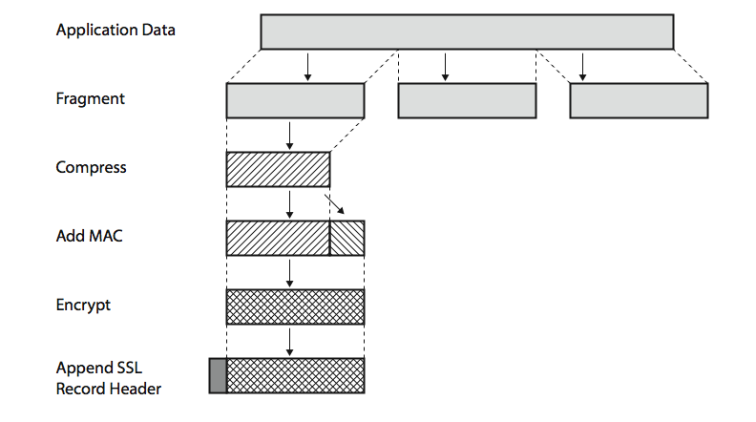
SSL 记录协议操作
Notes:
Stallings Figure 5.3 shows the overall operation of the SSL Record Protocol. The Record Protocol takes an application message to be transmitted, fragments the data into manageable blocks, optionally compresses the data, computes and appends a MAC (using a hash very similar to HMAC), encrypts (using one of the symmetric algorithms listed on the previous slide), adds a header (with details of the SSL content type, major/minor version, and compressed length), and transmits the resulting unit in a TCP segment. Received data are decrypted, verified, decompressed, and reassembled and then delivered to higher-layer applications. See text for additional details.

Slide 9
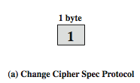
SSL 修改密码规格协议
应用SSL记录协议的3个SSL规格协议之一
只包含一条消息
使得挂起状态改变为当前状态
因此更新此连接使用的密码套件
Notes:
The Change Cipher Spec Protocol is one of the three SSL-specific protocols that use the SSL Record Protocol, and it is the simplest, consisting of a single message (shown in Stallings Figure 16.5a), which consists of a single byte with the value 1. The sole purpose of this message is to cause the pending state to be copied into the current state, which updates the cipher suite to be used on this connection.

Slide 10

SSL 警报协议
传达SSL相关警报给对等实体
严重性
警告 或者 致命
具体的警报
致命: 非预期消息, MAC记录出错, 解压缩失败, 握手失败, 不合法参数
警告: 结束通知, 没有证书, 证书不可用, 不支持的证书, 证书撤销, 证书过期, 末知证书
压缩、加密所有的SSL消息
Notes:
The Alert Protocol is used to convey SSL-related alerts to the peer entity. As with other applications that use SSL, alert messages are compressed and encrypted, as specified by the current state.
Each message in this protocol consists of two bytes (as shown in Stallings Figure 16.5b), the first takes the value warning(1) or fatal(2) to convey the severity of the message. The second byte contains a code that indicates the specific alert. The first group shown are the fatal alerts, the others are warnings.

Slide 11

SSL 握手协议
允许“服务器和客户端”:
相互认证
协商加密和MAC算法
协商用于保护数据使用的密钥
由一系列消息组成
建立安全功能
服务器认证和密钥交换
客户端认证和密钥交换
完成
Notes:
The most complex part of SSL is the Handshake Protocol. This protocol allows the server and client to authenticate each other and to negotiate an encryption and MAC algorithm and cryptographic keys to be used to protect data sent in an SSL record. The Handshake Protocol is used before any application data is transmitted. The Handshake Protocol consists of a series of messages exchanged by client and server, which have the format shown in Stallings Figure 16.5c, and which can be viewed in 4 phases:
Phase 1. Establish Security Capabilities - this phase is used by the client to initiate a logical connection and to establish the security capabilities that will be associated with it
Phase 2. Server Authentication and Key Exchange - the server begins this phase by sending its certificate if it needs to be authenticated.
Phase 3. Client Authentication and Key Exchange - the client should verify that the server provided a valid certificate if required and check that the server_hello parameters are acceptable
Phase 4. Finish - this phase completes the setting up of a secure connection. The client sends a change_cipher_spec message and copies the pending CipherSpec into the current CipherSpec. At this point the handshake is complete and the client and server may begin to exchange application layer data.

Slide 12
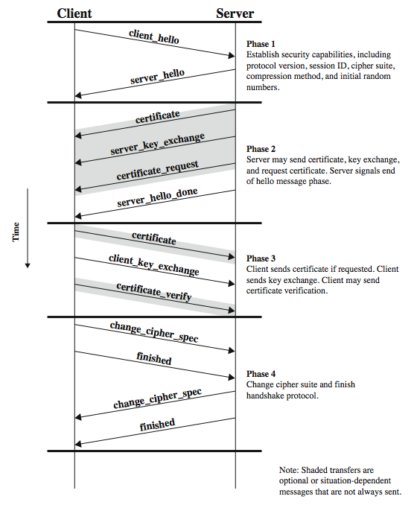
SSL 握手协议
Notes:
Stallings Figure 5.6 shows the initial exchange needed to establish a logical connection between client and server. The exchange can be viewed as having the four phases discussed previously. Additional details on the operation of these phases is given in the text.

Slide 13
密码计算
创建共享主密钥
一个一次性48字节的值
使用安全密钥交换 (RSA / Diffie-Hellman) 产生，接着得到这些信息的散列值
密码参数产生
客户端写MAC值的密钥, 服务器写MAC值密钥，客户端写密钥、服务器写密钥、客户端写初始向量IV，和服务器写初始向量IV
主密钥利用散列函数产生
Notes:
Two further items are of interest: the creation of a shared master secret by means of the key exchange, and the generation of cryptographic parameters from the master secret.
The shared master secret is a one-time 48-byte value (384 bits) generated for this session by means of secure key exchange. The creation is in two stages. First, a pre_master_secret is exchanged. Second, the master_secret is calculated by both parties. For pre_master_secret exchange, there are two possibilities, using either RSA or Diffie-Hellman. Both sides now compute the master_secret by hashing the relevant information, as detailed in the text.
CipherSpecs require a client write MAC secret, a server write MAC secret, a client write key, a server write key, a client write IV, and a server write IV, which are generated from the master secret in that order. These parameters are generated from the master secret by hashing the master secret into a sequence of secure bytes of sufficient length for all needed parameters.

Slide 14
TLS (传输层安全)
IETF 标准 RFC 2246 非常接近于 SSLv3
有一些小的不同点：
在记录规格版本号
使用 HMAC
一个伪随机函数扩展密钥
基于 HMAC 使用 SHA-1 or MD5
拥有额外的警告码
在支持的密码套件有一些改变
…
Notes:
TLS is an IETF standardization initiative whose goal is to produce an Internet standard version of SSL. TLS is defined as a Proposed Internet Standard in RFC 2246. RFC 2246 is very similar to SSLv3, but with a number of minor differences in the areas shown, as discussed in the text.

Slide 15
HTTPS
HTTPS (HTTP over SSL)
用 HTTP 和 SSL/TLS 的结合来实现网络浏览器和服务器之前的安全通信
规范文档可参阅 RFC2818
在SSL 或 TLS之上的HTTP 没有根本性区别
使用 https:// URL 而不是 http://
使用端口 443， 而不是 80
加密
URL, 文件内容, 表单内容, cookies, HTTP 报头的内容
Notes:
HTTPS (HTTP over SSL) refers to the combination of HTTP and SSL to implement secure communication between a Web browser and a Web server. The HTTPS capability is built into all modern Web browsers. Its use depends on the Web server supporting HTTPS communication. The principal difference seen by a user of a web browser is that URL (uniform resource locator) addresses begin with https:// rather than http://. A normal HTTP connection uses port 80. If HTTPS is specified, port 443 is specified, which invokes SSL. When HTTPS is used, the following elements of the communication are encrypted: URL of the requested document, Contents of the document, Contents of browser forms (filled in by browser user), Cookies sent from browser to server and from server to browser, and Contents of HTTP header. HTTPS is documented in RFC 2818, HTTP Over TLS. There is no fundamental change in using HTTP over either SSL or TLS, and both implementations are referred to as HTTPS.

Slide 16
HTTPS 使用
连接初始化
TLS 握手，然后 HTTP 请求
连接关闭
在 HTTP 记录有 “Connection: close”
TLS 层 交换 close_notify 警告
接着关闭 TCP 连接
TLS实例在关闭连接之前，发起一个关闭警报的交换
Notes:
For HTTPS, the agent acting as the HTTP client also acts as the TLS client. The client initiates a connection to the server on the appropriate port and then sends the TLS ClientHello to begin the TLS handshake. When the TLS handshake has finished. The client may then initiate the first HTTP request. All HTTP data is to be sent as TLS application data. Normal HTTP behavior, including retained connections is followed.
An HTTP client or server can indicate the closing of a connection by including in an HTTP record: “Connection: close”. This indicates that the connection will be closed after this record is delivered. The closure of an HTTPS connection requires that TLS close the connection with the peer TLS entity on the remote side, which will involve closing the underlying TCP connection. At the TLS level, the proper way to close a connection is for each side to use the TLS alert protocol to send a close_notify alert. TLS implementations must initiate an exchange of closure alerts before closing a connection. A TLS implementation may, after sending a closure alert, close the connection without waiting for the peer to send its closure alert, generating an "incomplete close". Note that an implementation that does this may choose to reuse the session. This should only be done when the application knows (typically through detecting HTTP message boundaries) that it has received all the message data that it cares about. HTTP clients must also be able to cope with a situation in which the underlying TCP connection is terminated without a prior close_notify alert and without a Connection: close indicator. Such a situation could be due to a programming error on the server, or a communication error that causes the TCP connection to drop. However, the unannounced TCP closure could be evidence of some sort of attack. So the HTTPS client should issue some sort of security warning when this occurs.

Slide 17
Secure Shell (SSH)
网络信息安全通信协议
相对简单和经济
SSH1 提供安全的远程登录装置
替换 TELNET 和其它不安全的远程登陆机制
还提供了客户端/服务器功能
SSH2 修补了一些安全缺陷
记录在标准 RFCs 4250 到 4254 中
SSH 客户端和服务器随处可见
远程登录/ X隧道 选择的方法
Notes:
Secure Shell (SSH) is a protocol for secure network communications designed to be relatively simple and inexpensive to implement. The initial version, SSH1 was focused on providing a secure remote logon facility to replace TELNET and other remote logon schemes that provided no security. SSH also provides a more general client/server capability and can be used for such network functions as file transfer and email. A new version, SSH2, fixes a number of security flaws in the original scheme. SSH2 is documented as a proposed standard in IETF RFCs 4250 through 4254. SSH client and server applications are widely available for most operating systems. It has become the method of choice for remote login and X tunneling and is a rapidly becoming one of the most pervasive applications for encryption technology outside of embedded systems.

Slide 18
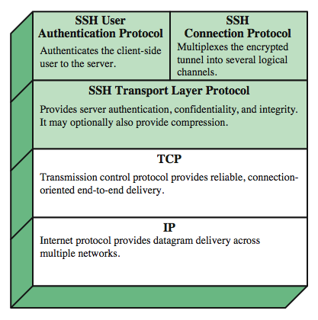
SSH 协议栈
Notes:
SSH is organized as three protocols that typically run on top of TCP (Stallings Figure 5.8):
• Transport Layer Protocol: Provides server authentication, data confidentiality, and data integrity with forward secrecy (i.e., if a key is compromised during one session, the knowledge does not affect the security of earlier sessions). The transport layer may optionally provide compression.
• User Authentication Protocol: Authenticates the user to the server.
• Connection Protocol: Multiplexes multiple logical communications channels over a single underlying SSH connection.

Slide 19
SSH 传输层协议
基于一对服务器/主机密钥，服务器认证发生在传输层
服务器认证需要客户端提前知道服务器的公共主机密钥
分组交换
建立 TCP 连接
接着交换消息
身份识别字符串交换, 算法协商, 密钥交换,密钥交换结束, 服务请求
使用特定的分组格式
Notes:
Server authentication occurs at the transport layer, based on the server possessing a public/private key pair. The server host key is used during key exchange to authenticate the identity of the host. For this to be possible, the client must have a priori knowledge of the server's public host key.
Next, consider events in the SSH Transport Layer Protocol. First, a client establishes a TCP connection to the server. Once the connection is established, the client and server exchange data, referred to as packets, in the data field of a TCP segment. Each packet has the format shown in Stallings Figure 16.10 and described in the text.
The SSH Transport Layer packet exchange consists of a sequence of steps. The first step, the identification string exchange, begins with the client sending a packet with an identification string. Next comes algorithm negotiation. Each side sends an SSH_MSG_KEXINIT containing lists of supported algorithms, one list for each type of cryptographic algorithm, in the order of preference to the sender. For each category, the algorithm chosen is the first algorithm on the client's list that is also supported by the server. The next step is key exchange. The specification allows for alternative methods of key exchange, but at present only two versions of Diffie-Hellman key exchange are specified. As a result of these steps, the two sides now share a master key K. In addition, the server has been authenticated to the client. The end of key exchange is signaled by the exchange of SSH_MSG_NEWKEYS packets. At this point, both sides may start using the keys generated from K, as discussed subsequently. The final step is service request. The client sends an SSH_MSG_SERVICE_REQUEST packet to request either the User Authentication or the Connection Protocol. Subsequent to this, all data is exchanged as the payload of an SSH Transport Layer packet, protected by encryption and MAC.

Slide 20
SSH 用户认证协议
提供用户向服务器证明自己身份的方法
三种消息类型:
SSH_MSG_USERAUTH_REQUEST
SSH_MSG_USERAUTH_FAILURE
SSH_MSG_USERAUTH_SUCCESS
使用认证方法
公开密钥, 口令密钥, 基于主机
Notes:
The User Authentication Protocol provides the means by which the client is authenticated to the server. Three types of messages are always used in the User Authentication Protocol. Authentication requests from the client have type SSH_MSG_USERAUTH_REQUEST. If the server either (a) rejects the authentication request, or (b) accepts the request but requires one or more additional authentication methods, the server sends a SSH_MSG_USERAUTH_FAILURE message that includes a list of methods that may productively continue the dialog. If the server accepts authentication then it sends a single byte message, SSH_MSG_USERAUTH_SUCCESS.
The server may require one or more of the following authentication methods:
publickey - client sends a message to the server that contains the client's public key, with the message signed by the client's private key
password - client sends a message containing a plaintext password, protected by TLS encryption
hostbased - authentication is performed on the client's host, rather than the client itself

Slide 21
SSH 连接协议
在SSH 传输层协议运行
假设使用了安全的认证连接
用一个通道虚拟出多条逻辑信道
Notes:
The SSH Connection Protocol runs on top of the SSH Transport Layer Protocol and assumes that a secure authentication connection is in use. That secure authentication connection, referred to as a tunnel is used by the Connection Protocol to multiple a number of logical channels. All types of communication using SSH, such as a terminal session, are supported using separate channels. Either side may open a channel. For each channel, each side associates a unique channel number, which need not be the same on both ends. Channels are flow controlled using a window mechanism. No data may be sent to a channel until a message is received to indicate that window space is available. The life of a channel progresses through three stages: opening a channel, data transfer, and closing a channel. Four channel types are recognized in the SSH Connection Protocol specification:
session - remote execution of a program
x11 - X Window System display traffic
forwarded-tcpip - remote port forwarding
direct-tcpip - local port forwarding

Slide 22
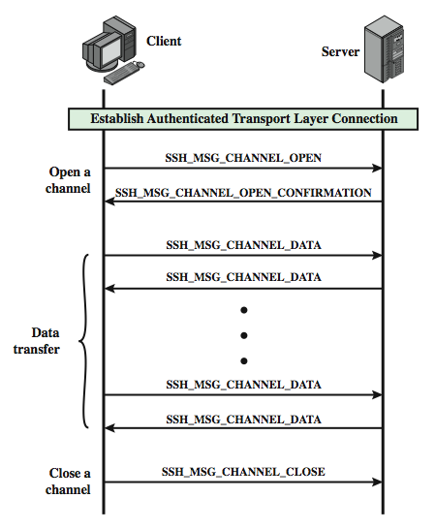
SSH 连接 协议交换
Notes:
Stallings Figure 5.11 provides an example of Connection Protocol Exchange.

Slide 23
端口转发
将任何不安全的TCP连接转换成安全的SSH连接
SSH 传输层协议在SSH客户端和服务器 建立一个TCP连接
客户端流量重定向到当地SSH，通过隧道转发，接着远程SSH传送到服务器
支持两种类型的端口转发
本地转发
远程转发
Notes:
One of the most useful features of SSH is port forwarding / tunneling. Port forwarding provides the ability to convert any insecure TCP connection into a secure SSH connection. Note that any application that runs on top of TCP has a port number. Incoming TCP traffic is delivered to the appropriate application on the basis of the port number. To secure such a connection, SSH is configured so that the SSH Transport Layer Protocol establishes a TCP connection between the SSH client and server entities, with TCP port numbers a and b, respectively. A secure SSH tunnel is established over this TCP connection. Traffic from the client at port x is redirected to the local SSH entity and travels through the tunnel where the remote SSH entity delivers the data to the server application on port y. Traffic in the other direction is similarly redirected.
SSH supports two types of port forwarding: local forwarding and remote forwarding. Local forwarding allows the client to set up a "hijacker" process. This will intercept selected application level traffic and redirect it from an unsecured TCP connection to a secure SSH tunnel. This could be used to secure the traffic from an email client on your desktop that gets email from the mail server via POP, the Post Office Protocol. With remote forwarding, the user's SSH client acts on the server's behalf. The client receives traffic with a given destination port number, places the traffic on the correct port and sends it to the destination the user chooses. This could be used to securely access a server at work from a home computer.

Slide 24
总结
传输层网络安全的需要
SSL/TLS 传输层安全协议
HTTPS
secure shell (SSH)
Notes:
Chapter 5 summary.

